Slide 1
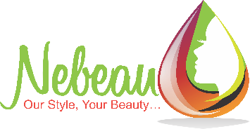
SULPHATE COMPARISON
Sulphate free – does not contain ANY sulphates
Salt free – does not contain Sodium chloride (can be used for Brazilian clients)
Chelating – contains Sodium Gluconate or similar ingredients that neutralizes minerals, chlorine, etc.
SLS/SLES free – does not contain these 2 sulphates, but may contain other sulphates
 | Sulphate free | Salt free | Chelating | Vegan | SLS/SLES free
Shecare Repair (300ml & 1L) | √ |  | √ | √ | √
Blondesse Blonde Miracle (300ml & 1L) | √ |  | √ | √ | √
Onlys (250ml & 1L) | √ | √ |  | √ | √
Vegliss (250ml) | √ | √ |  |  | √
Up 2 You Curl (300ml & 1L) | √ | √ |  | √ | √
Megix Color Saver (250ml & 1L) |  | √ |  |  | √
KS Hydra Komplex (250ml) | √ | √ | √ |  | √
Shecare Glazed (300ml & 1L) |  |  | √ | √ | √
Color Perfect (300ml & 1L) |  |  | √ | √ | √
Up 2 You Liss (300ml & 1L) |  |  | √ | √ | √
Greylosophy (300ml & 1L) |  |  |  | √ | √
Prep shampoo (300ml & 1L) |  |  | √ | √
Keratin restructuring (300ml & 1L) |  |  |  |  | √

